Slide 1
Budweiser
Craft Beer Exploratory Data Analysis
By Michael Mazel and Alexandre Jasserme
Link for video: http://youtube.com/ajasserme

Slide 2
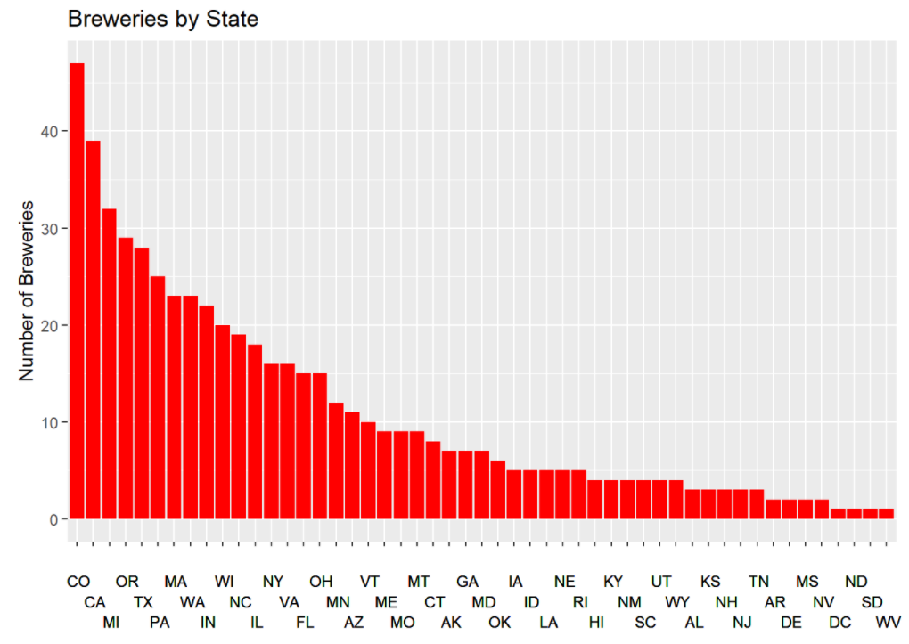
Breweries by State
State | n | State | n
AK | 7 | MT | 9
AL | 3 | NC | 19
AR | 2 | ND | 1
AZ | 11 | NE | 5
CA | 39 | NH | 3
CO | 47 | NJ | 3
CT | 8 | NM | 4
DC | 1 | NV | 2
DE | 2 | NY | 16
FL | 15 | OH | 15
GA | 7 | OK | 6
HI | 4 | OR | 29
IA | 5 | PA | 25
ID | 5 | RI | 5
IL | 18 | SC | 4
IN | 22 | SD | 1
KS | 3 | TN | 3
KY | 4 | TX | 28
LA | 5 | UT | 4
MA | 23 | VA | 16
MD | 7 | VT | 10
ME | 9 | WA | 23
MI | 32 | WI | 20
MN | 12 | WV | 1
MO | 9 | WY | 4
MS | 2
All 50 states have breweries. DC is counted as a state in this dataset

Slide 3
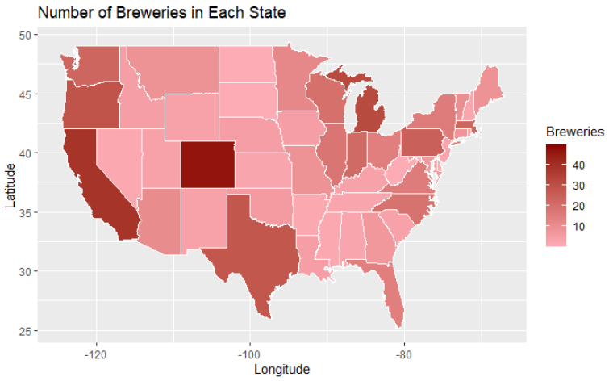
Map of Breweries by State

Slide 4
Missing Values
We found missing values in 3 columns:
ABV column has 62 missing values
IBU column has 1005 missing values
Style column has 5 missing values
We will keep rows that contain missing values, but some analyses, such as finding the average, ignores these absences.
Some missing values are expected, however (e.g. IBU for ciders).

Slide 5
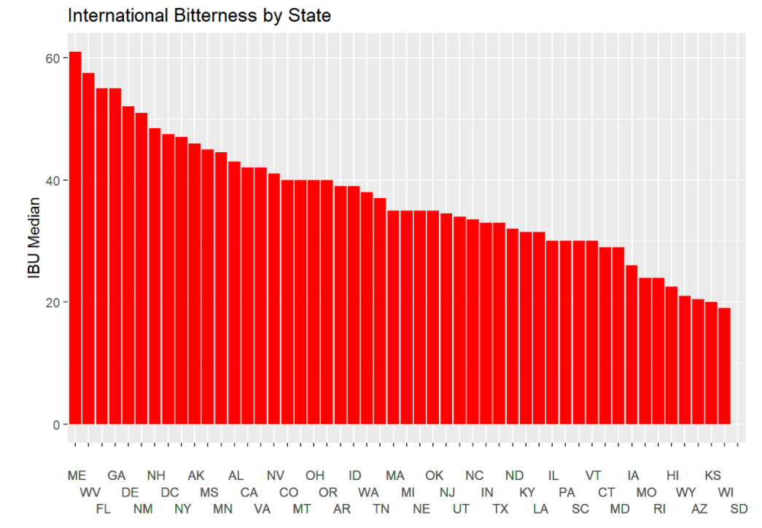
IBU by State

Slide 6
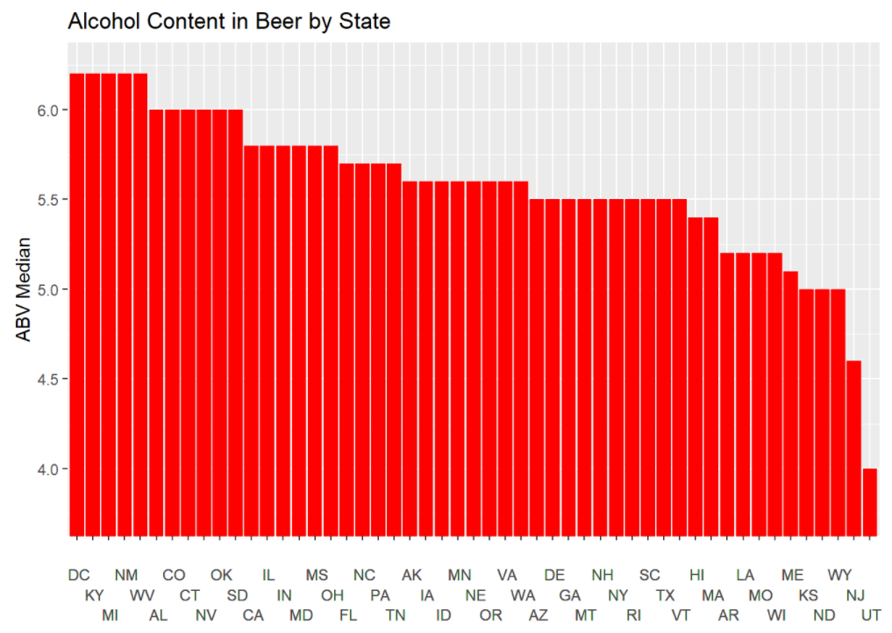
ABV by State

Slide 7
Which State has Highest ABV and IBU?
Colorado has the most alcoholic (ABV) beer with a value of 0.128.
It's the "Lee Hill Series Vol. 5 - Belgian Style Quadrupel Ale" made by “Upslope Brewing Company" in Boulder, CO.
Oregon has the most bitter (IBU) beer with a value of 138.
It's the "Bitter Bitch Imperial IPA" made by "Astoria Brewing Company" in Astoria, OR

Slide 8
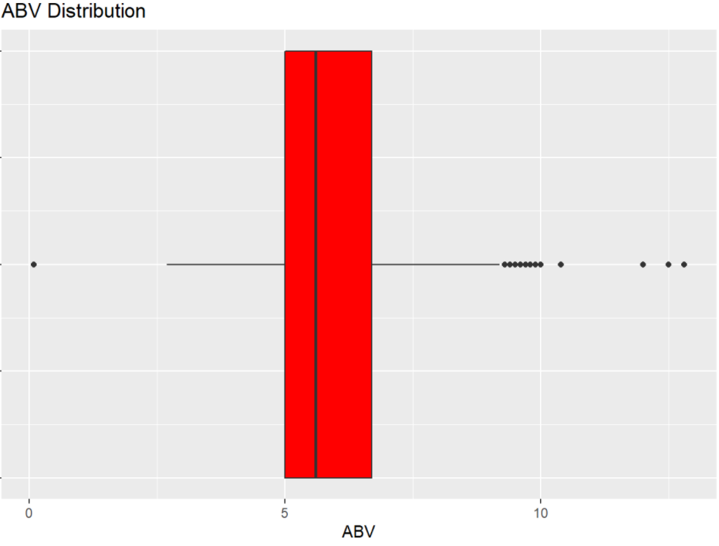
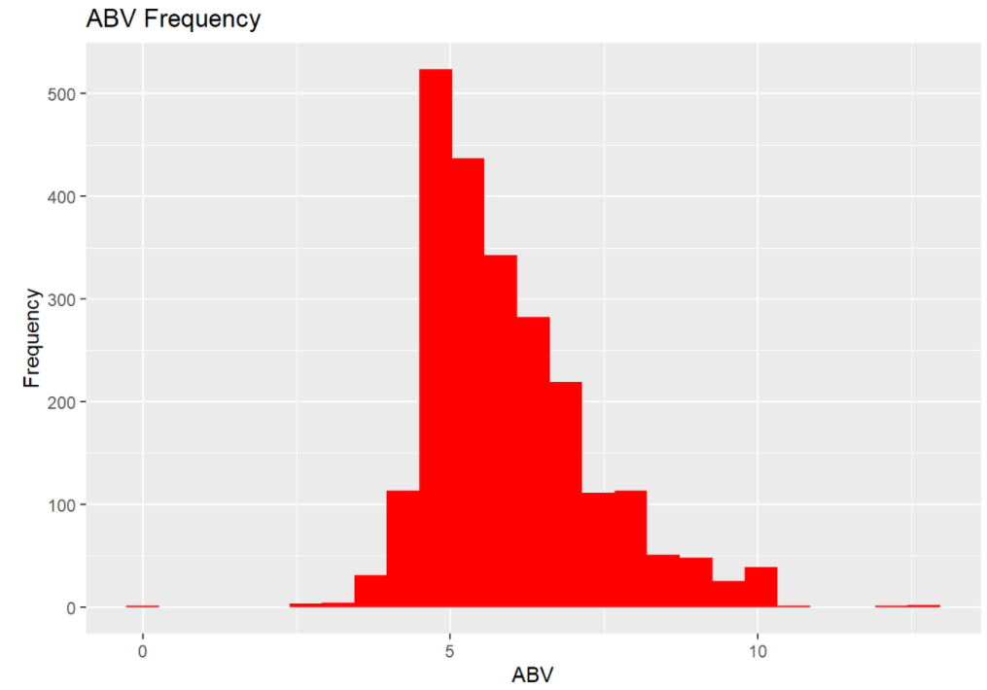
ABV Further Exploration
Min | Q1 | Med | Q3 | Max
0.1 | 5.0 | 5.6 | 6.7 | 12.8
Mean: 6.0

Slide 9
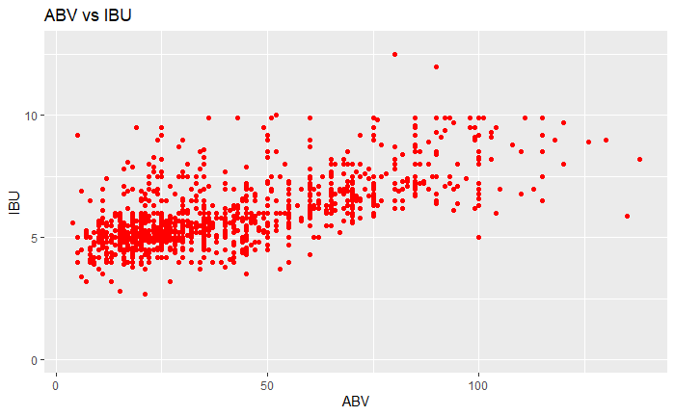
Relationship Between ABV and IBU
Positive relationship between ABV and IBU, with a linear correlation value of 0.67
0 represents no relationship whatsoever
1 represents a perfect association

Slide 10
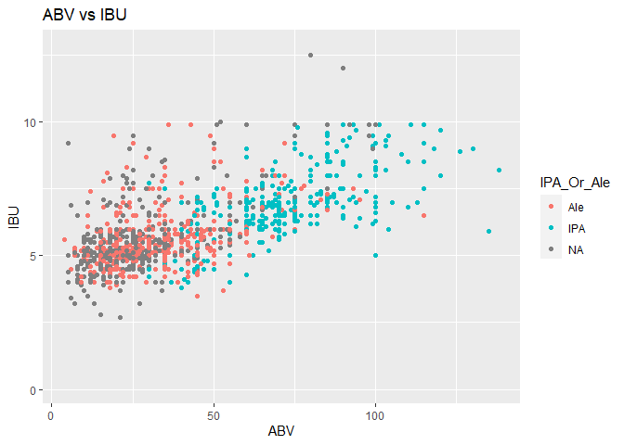
Predicting IPA or Ale
Accurately predicted 85.5%
Variables that were poor predictors:
Ounces
Location of where the beer was sourced
Length of the beer name

Slide 11
Other Insights
All Styles
Ciders and Fruit/Vegetable Beers
State | # of Beers from State | Percent Out of All Beers
Colorado | 265 | 11%
California | 183 | 7.6%
Michigan | 162 | 6.7%
Indiana | 139 | 5.8%
Texas | 130 | 5.4%
State | # of Beers from State | Percent Out of All Beers
Michigan | 17 | 19.8%
Oregon | 9 | 10.5%
California | 5 | 5.8%
Indiana | 5 | 5.8%
Massachusetts | 5 | 5.8%

Slide 12
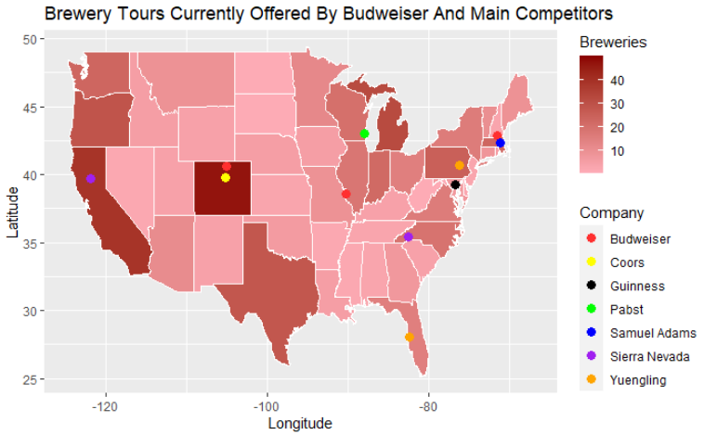
Breweries Offering Public Tours

Slide 13

Proposal
Add public tour option to Budweiser breweries in Houston and Los Angeles

Slide 14
Appendix

Slide 15
Median ABV and IBU per State
State | ABV | IBU | State | ABV | IBU
AK | 5.6 | 46 | MT | 5.5 | 40
AL | 6 | 43 | NC | 5.7 | 33.5
AR | 5.2 | 39 | ND | 5 | 32
AZ | 5.5 | 20.5 | NE | 5.6 | 35
CA | 5.8 | 42 | NH | 5.5 | 48.5
CO | 6 | 40 | NJ | 4.6 | 34.5
CT | 6 | 29 | NM | 6.2 | 51
DC | 6.2 | 47.5 | NV | 6 | 41
DE | 5.5 | 52 | NY | 5.5 | 47
FL | 5.7 | 55 | OH | 5.8 | 40
GA | 5.5 | 55 | OK | 6 | 35
HI | 5.4 | 22.5 | OR | 5.6 | 40
IA | 5.6 | 26 | PA | 5.7 | 30
ID | 5.6 | 39 | RI | 5.5 | 24
IL | 5.8 | 30 | SC | 5.5 | 30
IN | 5.8 | 33 | SD | 6 | NA
KS | 5 | 20 | TN | 5.7 | 37
KY | 6.2 | 31.5 | TX | 5.5 | 33
LA | 5.2 | 31.5 | UT | 4 | 34
MA | 5.4 | 35 | VA | 5.6 | 42
MD | 5.8 | 29 | VT | 5.5 | 30
ME | 5.1 | 61 | WA | 5.6 | 38
MI | 6.2 | 35 | WI | 5.2 | 19
MN | 5.6 | 44.5 | WV | 6.2 | 57.5
MO | 5.2 | 24 | WY | 5 | 21
MS | 5.8 | 45

Slide 16
Duplicate Values
There are fewer than 100 rows with identical values. Are there any guidance on how these should be addressed?

Slide 17
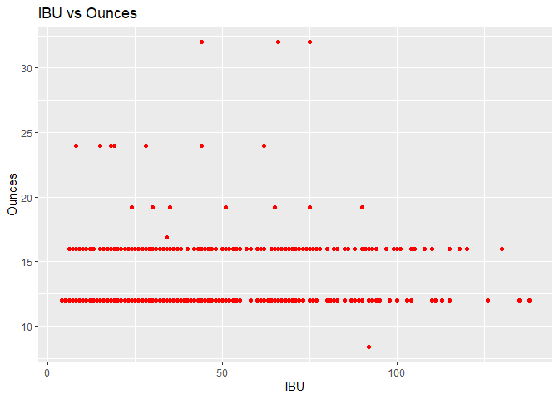
Other Insights
There is evidence to conclude that IBU and Ounces are correlated (p-value .04).

